Slide 1

Advanced Keylogger with Telegram Integration
A Python-based Remote Keylogger with Real-Time Logging
Manish Naik | AGMR collage of Engineering & Technology Hubli | 19-02-2025

Slide 2


What is a Keylogger?
A keylogger records keystrokes typed by the user.
Used for monitoring and security purposes.
This project sends logs to Telegram for remote access.

Slide 3
With great power comes great responsibility. A keylogger in the wrong hands is a weapon; in the right hands, it's a tool for security and monitoring.
“
”

Slide 4
Objectives
Develop a Python-based keylogger.
Capture keystrokes and store logs.
Send logs to Telegram in real-time.
Run in stealth mode.
Implement basic anti-detection techniques.

Slide 5

Primary goals
Parental Controlling

Slide 6
System Architecture
Client-Server Model:
Client: Keylogger captures keystrokes.
Server: Telegram Bot stores and displays logs.
Diagram representation of data flow.

Slide 7
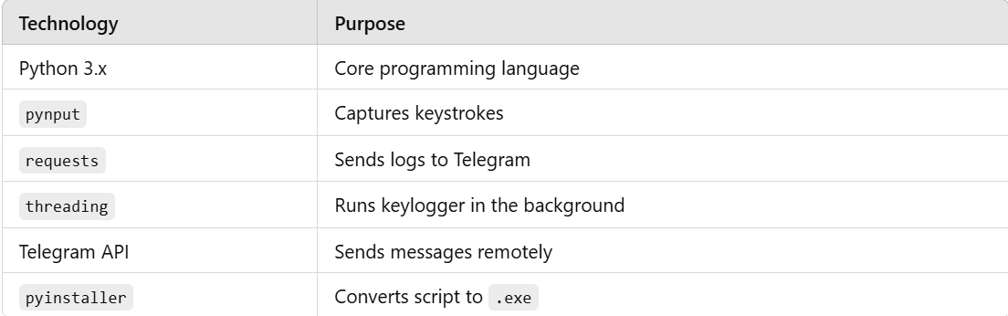
Tools and Technologies

Slide 8

Creating a Telegram Bot
Open Telegram and search for BotFather.
Use /newbot command to create a bot.
Save the BOT_TOKEN for integration.
Find your Chat ID using API.

Slide 9
Writing the Keylogger Script
Steps:
Import necessary Python libraries.
Capture keystrokes using pynput.
Save logs in a text file.
Send logs to Telegram periodically.
Code Snippet: (A short preview of the Python script)

Slide 10
Execution Steps
Install dependencies:
bash
pip install pynput requests pyinstaller
Run the script:
bash
python keylogger.py
Check Telegram for logs.
Convert script to .exe (for deployment):
bash
pyinstaller --onefile --noconsole keylogger.py

Slide 11
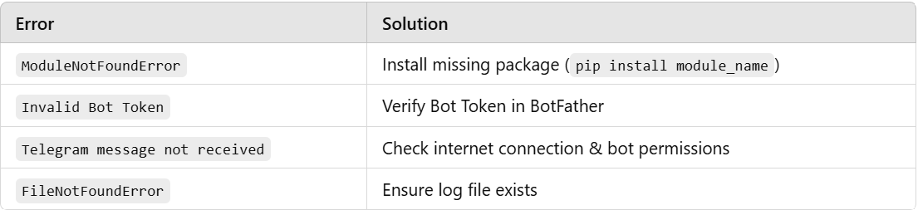
Error Handling

Slide 12
Security & Ethical Considerations
Legal Use Cases:
Parental control.
Personal security.
Penetration testing.
Illegal Use Cases:
Unauthorized data collection (Cybercrime).
Always get consent before using keyloggers!

Slide 13
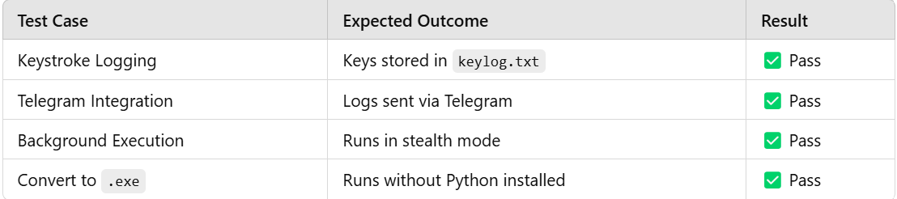
Testing & Results

Slide 14
Limitations
No GUI – Runs in the background.
Only keystrokes recorded – No screenshots.
May be detected by antivirus.

Slide 15
Future Enhancements
Clipboard Monitoring – Capture copied text.
Screenshot Capturing – Take periodic screenshots.
Encryption – Secure logs using encryption.
Self-Destruction – Delete logs after sending.

Slide 16

Conclusion
Successfully implemented Python-based keylogger.
Integrated with Telegram API for remote logging.
Runs in stealth mode for background execution.
Use responsibly and ethically!
Thank You! Questions?

Slide 17

Thank you
Manish Naik
manishmnaik20@gmail.com
https://github.com/manishnaik20

